Slide 1
Inheritance, Interfaces and Polymorphism

Slide 2
4.1 The Concept of Inheritance
A car is a wheeled vehicle.
The is-a relationship arises in the context of the inheritance concept.

Slide 3
Car vs. Vehicle
public class Car {
public Car() {
this(0, 0);
}
public Car(double width, double height) {
this.width = width;
this.height = height;
}
public double area() {
return width * height;
}
public void setLocation(Point p){
currentLocation = p;
}
public void setLocation(int x, int y){
Point p = new Point(x, y);
currentLocation = p;
}
private double width, height;
//The current location of this object
private Point currentLocation;
}
public class Vehicle{
public void setLocation(Point p){
currentLocation = p;
}
public void setLocation(int x, int y){
Point p = new Point(x, y);
currentLocation = p;
}
//The current location of this object
Point currentLocation;
}
It can be seen that Vehicle and Car have common attributes and behaviors.

Slide 4
Point class
public void setXY(int x, int y) {
this.x = x;
this.y = y;
}
public String toString() {
return "[" + getX() + ", " + getY() + "]";
}
private int x; // x part of coordinate pair
private int y; // y part of coordinate pair
}
public class Point {
public Point() {
}
public Point(int xValue, int yValue) {
x = xValue;
y = yValue;
}
// return x from coordinate pair
public int getX() {
return x;
}
// return y from coordinate pair
public int getY() {
return y;
}

Slide 5
extends
In order to share the attributes and behaviors of Vehicle,
use the keyword extends to declare the class Car from class Vehicle:
public class Car extends Vehicle {
public Car() {
this(0, 0);
}
public Car(double width, double height) {
this.width = width;
this.height = height;
}
public double area() {
return width * height;
}
private double width, height;
}

Slide 6
Inheritance继承
Class Vehicle is a parent class (base class, super class)父类、基类、超类 while Car is a child class (extended class, derived class) 子类、扩展类、继承类in such a situation.
A subclass inherits all of the "public" and "protected" members (variables or methods) of its parent, no matter what package the subclass resides in.
If the subclass is in the same package as its parent, it also inherits the package-private（默认访问权限） members of the parent.

Slide 7
Inheritance
Point aPoint = new Point(2,2);
Car a = new Car(3,6);
a.setLocation(aPoint);
For example, the following client code fragment of class Car can use the method setLocation() even though it is declared in the parent class of Car.

Slide 8
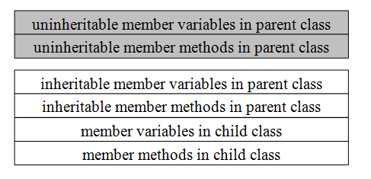
Inheritance
The object initialized from a child class consists of both member variables from the parent object and the member variables from itself.

Slide 9
Inheritance
For the class Vehicle and class Car declared above, it is valid to use currentLocation from the parent class in the methods of the child class:
currentLocation.setXY(10, 20);
However, if the member variable currentLocation of class Vehicle becomes private:
private Point currentLocation;
A compilation error occurs: currentLocation has private access in Vehicle.

Slide 10
Inheritance
public class Vehicle{
public Vehicle(){
currentLocation = new Point(0,0);
}
public Vehicle(Point location){
this.currentlocation = location;
}
public void setLocation(Point p){
currentLocation = p;
}
public void setLocation(int x, int y){
currentLocation.setXY(x, y);
}
//return the current location of this Vehicle
public Point getLocation(){
return currentLocation;
}
Point currentLocation; //The current location of this object
}
Car a = new Car(new Point(10,10), 2, 4);
System.out.println(a.getLocation());
results in output as follows:
[10, 10]
However, if getLocation() is private, it can not be used by Car directly.

Slide 11
Inheritance
In Java, all classes are extended from the Object superclass.
The Object class is the only class that does not have a parent class.
It defines and implements behavior common to all classes such as equals(), toString() and so forth.

Slide 12
Inheritance and composition继承和组合
“is-a”(是一个)的关系是用继承来表述
“has-a”(有一个)的关系是用组合来表述
组合语法
class Engine {
public void start() {}
public void rev() {}
public void stop() {} }
public class Car {
Engine engine = null ;
public Car() {
engine = new Engine(); //轮胎和引擎是汽车的一部分 }
}

Slide 13
组合的优缺点
优点
被包含对象通过包含他们的类来访问 黑盒重用，因为被包含对象的内部细节是不可见的 很好的封装 每个类专注于一个任务 通过获得和被包含对象的类型相同的对象引用，可以在运行时动态定义组合的方式
缺点
系统可能会包含更多的对象
为了使组合时可以使用不同的对象，必须小心的定义接口

Slide 14
继承的优缺点
优点
新的实现很容易，因为大部分是继承而来的
很容易修改和扩展已有的实现
缺点
打破了封装，因为基类向子类暴露了实现细节
白盒重用，因为基类的内部细节通常对子类是可见的
当父类的实现改变时可能要相应的对子类做出改变
不能在运行时改变由父类继承来的实现
由此可见，组合比继承具有更大的灵活性和更稳定的结构，一般情况下应该优先考虑组合。

Slide 15
使用继承的条件
子类是一种特殊的类型，而不只是父类的一个角色
子类的实例不需要变成另一个类的对象
子类扩展，而不是覆盖或者使父类的功能失效

Slide 16
4.2 Constructors of Superclass and Subclass
A subclass constructor invokes the constructor of the superclass implicitly. When a Car object, is instantiated as a subclass, the default constructor (nonparameter constructor) of its superclass, Vehicle class, is invoked implicitly before the subclass's constructor method is invoked.
A subclass cannot inherit constructors from a superclass since the name of a constructor is same as the name of its class. A subclass constructor can invoke the constructor of the superclass explicitly by using the super keyword. The invocation statement must on the first line in the constructor body in this case.

Slide 17
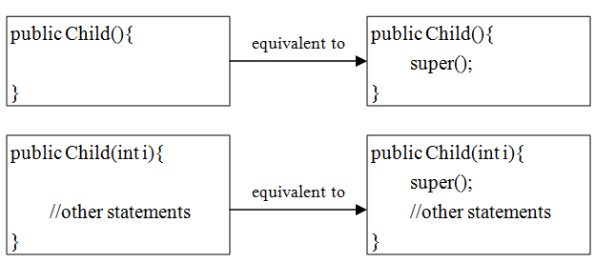
Constructors
Default situation

Slide 18
Constructors
public class Vehicle{
public Vehicle(){
currentLocation = new Point(0,0);
}
public Vehicle(Point location){
this.currentLocation = location;
}
public void setLocation(Point p){
currentLocation = p;
}
public void setLocation(int x, int y){
currentLocation.setXY(x, y);
}
Point currentLocation; //The current location of this object
}
Remember that if a class defines an explicit constructor, Java no longer provides any default constructor.

Slide 19
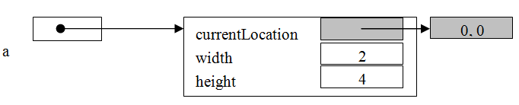
Constructors
Car a = new Car(2, 4);

Slide 20
Constructors
If the position of a new Car object needs to be assigned instead of a default position, the subclass Car can also explicitly calls a constructor of its immediate superclass Vehicle：
public class Car extends Vehicle{
public Car(Point topLeft, double width, double height) {
super(topLeft);
this.width = width;
this.height = height;
}
…
}

Slide 21
Constructors
The keyword super can be used in two ways:
to call a superclass constructor,
to call a superclass method.

Slide 22
Constructors
In any case, constructing an instance of a class invokes the constructors of all the superclasses along the inheritance chain.
A superclass's constructor is called before the subclass's constructor.
This is called constructor chaining.

Slide 23
Constructors
class Ancestor {
Ancestor() {
System.out.println("Ancestor.");
}
}
class Parent extends Ancestor {
Parent() {
System.out.println("Parent.");
}
}
class Child extends Parent{
Child(){
System.out.println("Child.");
}
public static void main(String[] args) {
Child c = new Child();
}
}
The result is:
Ancestor.
Parent.
Child.

Slide 24
4.3 Method Overriding方法覆盖
When a subclass method matches in name and in the number, type and sequence of arguments to the method in the superclass, that is, the method signatures match, the subclass is said to override that method.
方法名、参数数量、类型、顺序完全相同

Slide 25
Overriding Point class
public void setXY(int x, int y) {
this.x = x;
this.y = y;
}
//public String toString() {
// return "[" + getX() + ", " + getY() + "]";
// }
private int x; // x part of coordinate pair
private int y; // y part of coordinate pair
}
public class Point {
public Point() {
}
public Point(int xValue, int yValue) {
x = xValue;
y = yValue;
}
// return x from coordinate pair
public int getX() {
return x;
}
// return y from coordinate pair
public int getY() {
return y;
}

Slide 26
Overriding
toString() is an instance method provided by java.lang.Object. It returns a string representation of the object. When the following fragment of code is run,
Point aPoint = new Point(2,2);
System.out.println(aPoint);
the output is [2, 2].
If there is no method provided in Point overriding toString(), the default output is:
Point@9cab16 类名+哈希码

Slide 27
Overriding
System.out.println(object) is equivalent to invoking System.out.println(object.toString()).

Slide 28
Overriding
An instance method can be overridden only if it is accessible.
可见方法才能被覆盖
Therefore, neither a private method nor a static method can be overridden.
If a static method defined in the superclass is redefined in a subclass, the method defined in the superclass is hidden隐藏.

Slide 29
Overriding
public class A {
public static void testClassMethod() {
System.out.println("The class method in A.");
}
public void testInstanceMethod() {
System.out.println("The instance method in A.");
}
}
public class B extends A {
public void testClassMethod() { // Cause a compile-time error
System.out.println("The class method in B.");
}
public static void testInstanceMethod() { //Cause a compile-time error
System.out.println("The instance method in B.");
}
}
This instance method cannot override the static method from A
This static method cannot hide the instance method from A

Slide 30
Overloading and Overriding
Overloading 重载
public class A {
...
void doSomething () {..}
void doSomething (int i) {..}
void doSomething (float x) {..}
void doSomething (float x, float y) {..}
}

Slide 31
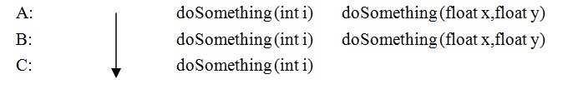
Overloading and Overriding
The methods of the base class and subclasses are overridden vertically below the base class:
Overriding覆盖
public class B extends A{
...
void doSomething (int i){ }
void doSomething (float x, float y){ }
}
public class C extends B {
void doSomething (int i){ }
}

Slide 32
4.4 Upcasting and Downcasting 向上转型和向下转型
Upcasting and downcasting are important features of Java, which allow us to build complicated programs using simple syntax.
Java permits an object of a subclass type to be referred to as an object of any superclass type. This is called upcasting.
将子类对象看做父类对象称之为向上转型
反之为向下转型
Upcasting is done automatically, 向上转型自动完成
Downcasting is done manually. 向下转型需通过强制转换手工完成

Slide 33
4.4 Upcasting and Downcasting
Car a = new Car ();
Vehicle s = a;
In order to upcast the Car object, it just needs assignment from the object reference to a variable with Vehicle type.

Slide 34
4.4 Upcasting and Downcasting
Note that a client cannot visit the member variables within the subclass by a superclass reference, but can visit the methods belonging to the subclass.
被转型的对象使用父类的引用无法访问子类的成员变量，但可以访问子类的成员方法

Slide 35
4.4 Upcasting and Downcasting
class P {
int i = 8;
P(){
aMethod();
}
public void aMethod(){
System.out.println("I am a method in P.");
}
}
public class C extends P{
int i = 9;
public static void main(String argv[]){
P p = new C();
System.out.println(p.i);
p.aMethod();
}
public void aMethod(){
System.out.println("I am a method in C.");
}
}
8
I am a method in C.
父类的成员变量，子类的方法
如果子类中的成员变量名称与父类中的成员变量名称完全相同，则父类成员变量称之为被隐藏

Slide 36
4.4 Upcasting and Downcasting
When we cast a reference along the class hierarchy in a direction from the ancestor class towards subclasses, it is a downcast.
The cast operator, (<subclass>), in front of a superclass object implements downcasting.
For example:
Vehicle s = new Vehicle();
Car a = (Car) s;

Slide 37
4.4 Upcasting and Downcasting
For the casting to be successful, the programmer must ensure that the object to be cast is an instance of the subclass
只有确定对象是子类对象时才能使用向下转型
In order to ensure that an object is an instance of another object before attempting a casting, the instanceof operator is used.

Slide 38
4.4 Upcasting and Downcasting
Vehicle aVehicle = new Car(); //upcasting implicitly
Car t;
if (a instanceof Car ){
// explict casting after confirmation
t = (Car)aVehicle;
}

Slide 39
4.4 Upcasting and Downcasting
class A {
}
class B extends A {
}
public class InstanceOf {
public static void main(String[] args) {
A x = new A();
System.out.println("x instanceof A " + (x instanceof A));
System.out.println("x instanceof B " + (x instanceof B));
System.out.println("x.getClass() == A.class " + (x.getClass() == A.class));
System.out.println("x.getClass() == B.class " + (x.getClass() == B.class));
System.out.println("x.getClass().equals(A.class)) " + (x.getClass().equals(A.class)));
System.out.println("x.getClass().equals(B.class)) " + (x.getClass().equals(B.class)));
}
}
It displays:
x instanceof A true
x instanceof B false
x.getClass() == A.class true
x.getClass() == B.class false
x.getClass().equals(A.class)) true
x.getClass().equals(B.class)) false

Slide 40
程序绑定Binding
绑定指的是一个方法的调用与方法所在类(方法主体)的关联形式
静态绑定static binding（前期绑定early binding）：
在程序执行前方法已经被绑定
java中的final，static，private和构造方法是前期绑定的
动态绑定dynamic binding（后期绑定late binding）：
在运行时根据具体对象的类型进行绑定

Slide 41
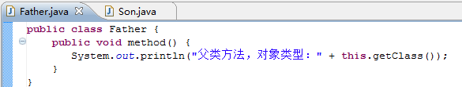
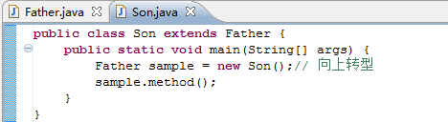

Dynamic binding
声明的是父类的引用，但调用的是子类的对象，调用method方法时，子类中没有该方法，所以调用父类中的该方法

Slide 42
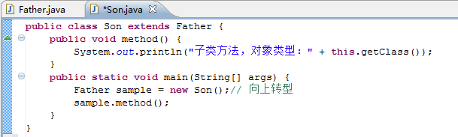

Dynamic binding
调用method方法时，在子类中找到了该方法，直接调用

Slide 43
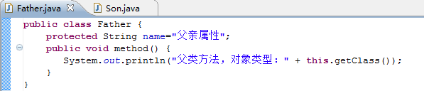
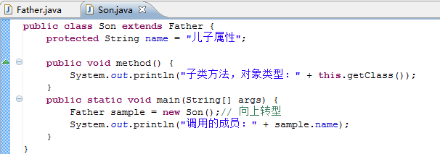

Dynamic binding
由父类的引用的子类的对象调用到的是父类的成员变量。
动态绑定只针对对象的方法。

Slide 44
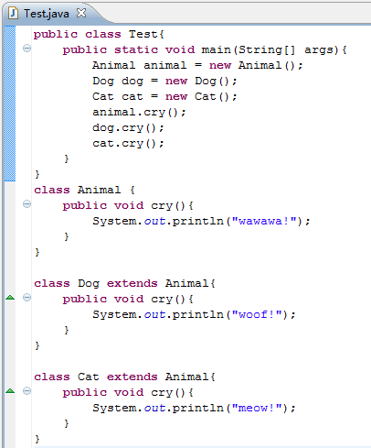
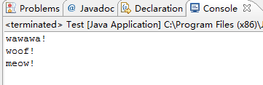
动态绑定的作用

Slide 45
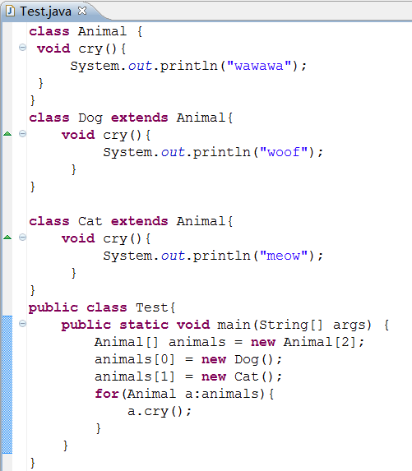
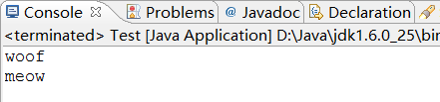
动态绑定的作用
用父类或接口指向子类或接口的实现类来提高灵活性，降低耦合度
比如在方法中声明狗类的引用来指向一个狗类的对象，那么在需要用到猫类进行同一动作时，需要另写代码；如果使用动物类的应用来指向的这两种类的对象，那么此方法对于所有继承动物类的对象都适用

Slide 46
多态Polymorphism
多态是面向对象程序设计的重要部分，是面向对象的3个基本特性之一。在Java语言中，通常使用方法的重载（Overloading）和覆盖（Overriding）实现类的多态性。

Slide 47
各机制之间的关系
访问
权限
类
封装
继承
（狭义）
继承
（广义）
覆盖
组合
向上转型
重载
多态
动态绑定

Slide 48
4.5 Abstract Class and Abstract Method
An abstract class is a class declared with the abstract keyword.
The key word says that the class cannot be instantiated, which is the only thing the abstract keyword does.

Slide 49
abstract
abstract class Vehicle{
…
public abstract void beep();
}
class Car extends Vehicle{
…
public void beep(){
//Codes here for beep behavior
}

Slide 50
Abstract
Only abstract classes can have abstract methods.
However, an abstract class does not necessarily require all of its methods to be abstract.
When a method is declared abstract, the method cannot have any definition.
This is the only effect the abstract keyword has on methods.

Slide 51
Abstract
There is no computation provided in the body of the method area () since the values are unknown at this point.
As a Vehicle, the class should provide area(); however, it depends on a concrete vehicle to calculate the area.
public class Vehicle {
public Vehicle(){
location = new Point(0,0);
}
public Vehicle(Point location){
this.location = location;
}
// return area of Vehicle; 0.0 by default
public double area() {
return 0.0;
}
// return the loation of this Vehicle
public Point getLocation(){
return location;
}
Point location;
}

Slide 52
Abstract
public abstract class Vehicle {
public Vehicle(){
location = new Point(0,0);
}
public Vehicle(Point location){
this.location = location;
}
abstract public double area() ;
// return the loation of this Vehicle
public Point getLocation(){
return location;
}
Point location;
}
New version
Note that the class must be declared as abstract because the method area is abstract.

Slide 53
Abstract
The key word abstract means that Vehicle class cannot create its object and its subclass must provide implementation for the abstract methods.
Vehicle类本身不能够创建对象，但它的子类必须为其抽象方法提供实现
抽象方法不能使用private或static关键字修饰

Slide 54
Abstract
The Calendar class in the java.util package is an abstract class for extracting detailed calendar information, such as year, month, date, hour, minute, and second.
The GregorianCalendar is a subclass of Calendar which implements the lunar calendar.
The constructor GregorianClanedar() is used to construct a default GregorianCalendar with the current time and the Gregoriancalendar(year, month, date) is used to construct a calendar with specified year, month and date.
Note that the month parameter is 0-based, that is, 0 for January.

Slide 55
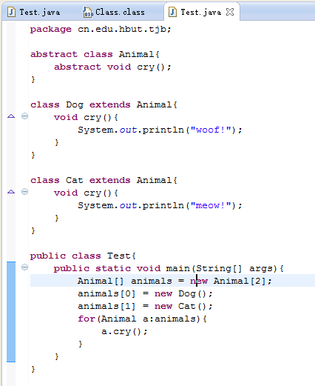
将Animal定义为抽象类，更符合实际情况，降低程序出错的风险。

Slide 56
4.8 Final Classes and Final Members
Final classes provide a way for preventing classes being extended.
This is achieved in Java by using the keyword final as follows:
final class A{
…
}

Slide 57
4.8 Final Classes and Final Members
The final member construct is a way for preventing overriding of members in subclasses.
This ensures that any functionality defined in this method cannot be altered in any way.
Similarly, the value of a final variable cannot be altered.
在类中声明中使用final
被定义成final的类不能在派生子类
在成员方法生命中使用final
被定义成final的方法不能被覆盖
在成员变量的声明中使用final
类的成员变量被定义成final,则变量一经赋值就不能改变

Slide 58
4.8 Final Classes and Final Members
public class FinalMember {
public FinalMember(String id) {
this.id = id;
}
public static void main(String[] args) {
FinalMember m1 = new FinalMember("m1");
m1.a2.i++;
m1.a1 = new A(9);
// Compile-time error
m1.a2 = new A(99);
for (int i = 0; i < m1.a.length; i++) {
m1.a[i]++;
}
FinalMember m2 = new FinalMember("m2");
System.out.println(m1);
System.out.println(m2);
}

Slide 59
4.8 Final Classes and Final Members
final public void doSomething() {
;
} // This method can not be overridden
public String toString() {
return id + ": " + "i = " + i + ", j = " + j;
}
private final int MEMBER_ONE = 1; // private instance constant
private final static int MEMBER_TWO = 2; // private class constant
public final static int MEMBER_THREE = 3; // public constant:
private String id;
private final int i = 100;
static final int j = 200;
private A a1 = new A(11);
private final A a2 = new A(22);
private static final A a3 = new A(33);
private final int[] a = { 1, 2, 3, 4, 5, 6 };
}

Slide 60
4.8 Final Classes and Final Members
class A {
public A(int i) {
this.i = i;
}
int i;
}
It displays:
m1: i = 100, j = 200
m2: i = 100, j = 200

Slide 61
4.6 Interfaces 接口
A method is essentially known to clients by its name and parameter specifications.
Clients do not need to know the implementation details of the method.
All they need to know is the method's name, parameters and return type (and sometimes its performance.)
In this way, interface and implementation are separated.

Slide 62
Interfaces
An interface is a named collection of method definitions (without implementations). 没有实现的方法定义
An interface can also declare constants常量.
A class implements 实现(key word) an interface rather than extends it.
Any class that implements an interface must override all the interface methods with its own methods.必须给接口中的所有方法写实现

Slide 63
Interfaces
By default, all the methods in an interface are public and abstract.
Fields in the interface are public, final, and static by default.
Note that interface methods are public, so the overriding methods in the classes that implement the interface must also be public.

Slide 64
public interface Computable {
public static final double PI = 3.1415926;
public abstract double sum( double x, double y);
public double sub(double x, double y);
//即使缺省abstract，系统会自动添加
}
接口没有构造方法，不能创建接口的对象。

Slide 65
接口－特征
接口是用来实现类间多重继承功能的结构.
接口不能实例化，即不能用new运算符创建对象。
一个类通过使用关键字implements声明自己实现一个或多个接口。
在类体中可以使用接口中定义的常量，而且必须实现接口中定义的所有方法
接口中的方法是自动公有的，在实现接口时必须把方法声明为public。接口中的方法都是抽象的。

Slide 66
Usage of interface
使用接口的好处：
可以先定义一个抽象类的协议而不管其具体实现。
多个类可共享相同的接口，相互间不用管其它类是如何定义该接口的方法。如果你使用了接口，其它用户就可以了解到如何调用这个类的方法。

Slide 67
Implements an interface
接口可以被类实现也可以被其他接口继承。在类中实现接口可以使用关键字implements。
语法格式为：
修饰符：可选。
类名：必选。
extends 父类名：可选参数
implements 接口列表：可选参数，用于指定该类实现哪些接口。当接口列表中存在多个接口名时，各个接口名之间使用逗号分隔。
[修饰符] class <类名> [extends 父类名] [implements 接口列表]{
}

Slide 68
example
例如定义一个Calculate接口，在该接口中定义一个常量PI和两个方法。
public interface Calculate {
final float PI=3.14159f;
float getArea(float r);
float getCircumference(float r);
}

Slide 69
Implements an interface
在类实现接口时，方法的名字、返回值类型、参数的个数及类型必须与接口中的完全一致，并且必须实现接口中的所有方法。例如创建实现Calculate接口的Circle类，可以使用如下代码：
public class Circle implements Calculate {
//实现计算圆面积的方法
public float getArea(float r) {
float area=PI*r*r; //计算圆面积并赋值给变量area
return area; //返回计算后的圆面积
}
//实现计算圆周长的方法
public float getCircumference(float r) {
float circumference=2*PI*r; //计算圆周长并赋值给变量circumference
return circumference; //返回计算后的圆周长
}
}

Slide 70
Implements an interface
每个类只能实现单重继承，而实现接口时，一次则可以实现多个接口，每个接口间使用逗号“,”分隔。这时就可能出现常量或方法名冲突的情况，解决该问题时，如果常量冲突，则需要明确指定常量的接口，这可以通过“接口名.常量”实现。如果出现方法冲突时，则只要实现一个方法就可以了。

Slide 71
Multi-Interfaces
interface A{ // 定义接口A public String AUTHOR = "李华" ; // 定义全局常量 public void print() ; // 定义抽象方法 public String getInfo() ; // 定义抽象方法 } interface B{ // 定义接口B public void say() ; // 定义抽象方法 } class X implements A,B{ // 子类同时实现两个接口 public void say() { // 覆写B接口中的抽象方法 System.out.println("Hello World!!!"); } public String getInfo() { // 覆写A接口中的抽象方法 return "HELLO"; } public void print() { // 覆写A接口中的抽象方法 System.out.println("作者：" + AUTHOR); } }

Slide 72
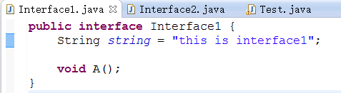
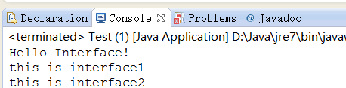
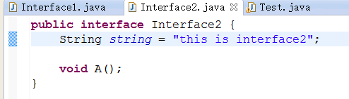
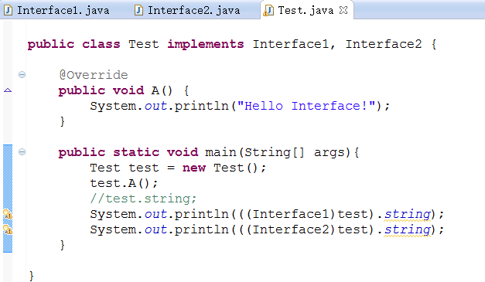
Multi-Interface

Slide 73
继承抽象类实现接口
一个子类可以同时继承抽象类和实现接口。
格式如下：
class 子类 extends 抽象类 implements 接口A,接口B,...{}

Slide 74
子类同时继承抽象类和实现接口
interface A{ // 定义接口A public String AUTHOR = "李兴华" ; // 定义全局常量 public void print() ; // 定义抽象方法 public String getInfo() ; // 定义抽象方法 } abstract class B{ // 定义抽象类 B public abstract void say() ; } class X extends B implements A{ // 子类同时实现接口 public void say() { // 覆写抽象类B中的抽象方法 System.out.println("Hello World!!!"); } public String getInfo() { // 覆写接口A中的抽象方法 return "HELLO"; } public void print() { // 覆写接口A中的抽象方法 System.out.println("作者：" + AUTHOR); } }

Slide 75
接口和抽象类的使用限制
在java中允许一个抽象类实现多个接口
interface A{ // 定义接口A public String AUTHOR = "李兴华" ; // 定义全局常量 public void print() ; // 定义抽象方法 public String getInfo() ; // 定义抽象方法 } abstract class B implements A{ // 定义抽象类，实现接口 public abstract void say() ; // 此时抽象类中存在三个抽象方法 } class X extends B{ // 子类继承抽象类 public void say() { // 覆写抽象类B中的抽象方法 System.out.println("Hello World!!!"); } public String getInfo() {// 覆写抽象类B中的抽象方法 return "HELLO"; } public void print() { // 覆写抽象类B中的抽象方法 System.out.println("作者：" + AUTHOR); } }

Slide 76
接口的继承
一个接口不能继承一个抽象类，但是却可以通过extends关键字同时继承多个接口，实现接口的多继承。
格式：
interface 子接口 extends 父接口A,父接口B,...{}

Slide 77
接口的多继承
interface A{ // 定义接口A public String AUTHOR = "李兴华" ; // 定义全局常量 public void printA() ; // 定义抽象方法 } interface B{ // 定义接口B public void printB() ; // 定义抽象方法 } interface C extends A,B{ // 定义接口C，同时继承接口A、B public void printC() ; // 定义抽象方法 } class X implements C{ // 子类实现接口C public void printA() { // 覆写接口A中的printA()方法 System.out.println("A、Hello World") ; } public void printB() { // 覆写接口B中的printB()方法 System.out.println("B、Hello MLDN") ; } public void printC() { // 覆写接口C中的printC()方法 System.out.println("C、Hello LXH") ; } }

Slide 78
抽象类和接口的区别和联系
一个类可以实现多个接口， 而一个类只能继承一个抽象类。
接口只定义方法，实现一个接口就是要实现接口的所有方法。而抽象类可以实现部分方法。
多个无关的类可以实现同一个接口，一个类可以实现多个无关的接口。

Slide 79
Interfaces
Abstract classes and interfaces are similar: both the interface and abstract class require implementation of the methods set.
However, they serve difference purposes.
An interface is a way to declare a set of methods that a class should implement.
By comparison, an abstract class provides a partial implementation, leaving it to subclasses to complete the implementation.
If an abstract class contains only abstract method declarations, it should be declared as an interface instead.
Therefore, abstract classes are most commonly subclasses to share pieces of implementation.

Slide 80
4.9 Access Control
There are two levels of access control:
class level
member level.
A class may be declared with the modifier public, in which case that class is visible to all classes.
If a class has no modifier (the default, also known as package-private), it is visible only within its own package.

Slide 81
4. 9 Access Control
The members of a class can be
public,
protected,
(default)
or private.

Slide 82
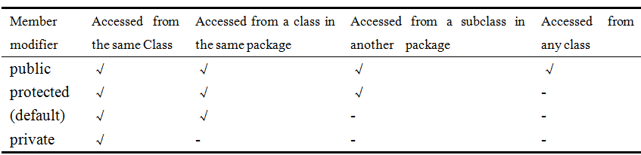
4.9 Access Control

Slide 83
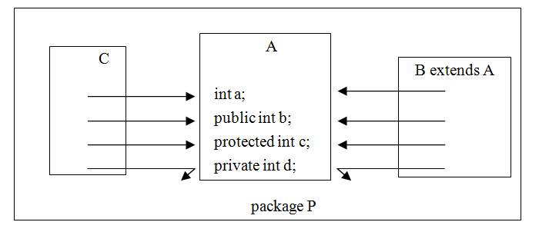
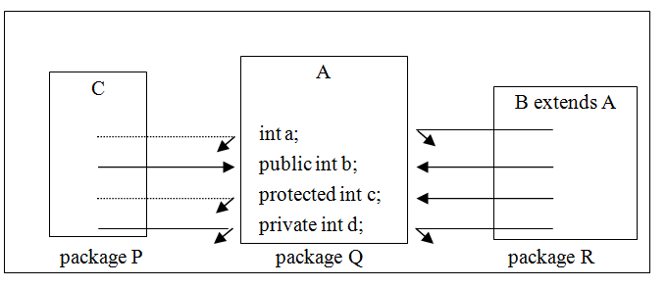
4.9 Access Control

Slide 84
public
如：class Tom
{ public int weight；
public int f(int a，int b)
{.......}
..........
}
方法 f 是
共有方法
当用类Tom创建了一个对象后，该对象
可以访问自己的public变量和public方法。

Slide 85
如：class Tom
{ public int weight；
public int f(int a，int b)
{.......}
..........
}
class Bob
{ void g()
{ Tom cat=new Tom()；
cat.weight=23;
cat.f(3，4)；
}
权限表示了对象访问自己的变量和使用类中的方法时的某种限制
合法

Slide 86
private
私有访问控制符
私有的
int型变量
如：class Tom
{ private int weight；
private int f(int a，int b)
{.......}
..........
}
方法 f 是
私有方法
当在另外一个类中用类Tom创建了一个对象后，该对象不能访问自己的私有变量和方法。

Slide 87
如：class Tom
{ private int weight；
private int f(int a，int b)
{.......}
..........
}
class Bob
{ void g()
{ Tom cat=new Tom()；
cat.weight=23;
cat.f(3，4)；
}
非法

Slide 88
缺省访问控制
缺省（友好\包）权限
如：class Tom
{ int weight；
int f(int a，int b)
{.......}
..........
}
class Bob
{ void g()
{ Tom cat=new Tom()；
cat.weight=23;
cat.f(3，4)；
}
方法 f 是
缺省方法

Slide 89
设：类Bob与类Tom在同一个包中，
则对象cat能访问自己的友好变量和友好方法。
缺省访问控制
如：class Tom
{ int weight；
int f(int a，int b)
{.......}
..........
}
class Bob
{ void g()
{ Tom cat=new Tom()；
cat.weight=23;
cat.f(3，4)；
}

Slide 90
protected
用protected修饰的成员变量 和方法被称为受保护的成员变量和受保护的方法。
若一个类继承了另一个类，则两个类不论是否在同一个包中，子类能够访问父类的protected成员。

Slide 91
以下程序中，类Bob与Tom在同一个包中
class Tom
{ protected float weight;
protected float f(float a,float b)
{
……
}
}
class Bob extends Tom
{ void g()
{ Tom cat=new Tom();
cat.weight=23f; //合法。
cat.f(3,4); //合法。
}
}

Slide 92
以下程序中，类Bob与Tom不在同一个包中
package tom.jf;
class Tom
{ protected float weight;
protected float f(float a,float b)
{ …… }
}
package sum.com;
import tom.jf.Tom;
class Bob extends Tom
{ void g()
{ Tom cat=new Tom();
cat.weight=23f; //合法
cat.f(3,4); //合法。
} }

Slide 93
4.10 Methods in the Object Class
Every class in Java is descended from the java.lang.Object class. If no inheritance is specified when a class is declared, the superclass of the class is Object by default. Therefore, the statement
public class Car{ }
is equivalent to
public class Car extends Object{ }
It is important to be familiar with the methods provided by the Object class so that you can use them in your classes

Slide 94
toString()
equals()
hashCode()
clone()

Slide 95
toString()
Invoking toString() on an object returns a string that represents the object.
By default, it returns a string consisting of a class name of which the object is an instance, an at sign(@) and the object's hash code in hexadecimal.

Slide 96
toString()
Usually, you should override the toString() method so that it returns a descriptive string representation of the object.

Slide 97
toString()
class Car{
public String toString() {
return "Car [name=" + name + ", width=" + width + ", height=" + height
+ "]";
}
private String name;
private double width, height;
}

Slide 98
equals()
The default implementation of the equals() method in the Object class is:
public boolean equals(Object obj){
return (this == obj)
}
This particular comparison is also known as “shallow comparison.”浅比较
it is really intended for the subclasses of the Object class to modify the equals method to test whether two distinct objects have the same states which is known as “deep comparison.”深比较

Slide 99
equals()
The Car class should provide an overriding method to compare whether two cars are equal based on their attributes, as follows:

Slide 100
equals()
class Car {
private int weight;
private String name;
public boolean equals(Object obj) {
if (this == obj)
return true;
if (obj == null)
return false;
if (getClass() != obj.getClass())
return false;
// object must be Car at this point
Car other = (Car) obj;
if (name == null) {
if (other.name != null)
return false;
} else if (!name.equals(other.name))
return false;
if (weight != other.weight)
return false;
return true;
}
}

Slide 101
equals()
The implementation of the equals() method usually follows these steps:
Firstly use the equality == operator to check if the argument is the reference to this object. This saves time when actual comparison is costly;首先比较是否是同一对象
Check that the argument is not null and it is of the correct type;
然后比较是否为空对象以及对象类型是否相同
The correct type could be any class or interface that one or more classes agree to implement for providing the comparison besides the same type or class as shown in the example above.
Cast the method argument to the correct type.
将对象转换成正确类型
Compare significant variables of both, the argument object and this object and check if they are equal.
比较重要双方的重要变量是否相同

Slide 102
hashCode()
Invoking hashCode() on an object returns the object's hash code.
The hash code is an integer that can be used to store the object in a hash set so that it can be located quickly.
The hashCode() implemented in the Object class returns the internal memory address of the object in hexadecimal.

Slide 103
hashCode()
If two objects are equal, their hash code must be same.
a user class should override the hashCode() method whenever the equals() method is overridden.
Two unequal objects may have the same hash code, but a hashCode() implementation should avoid too many such cases.

Slide 104
hashCode()
The hash code for a String object is computed as

Slide 105
hashCode()
One of the algorithms sums up all the products of all the member variables with different prime numbers.
class Car {
private int weight;
private String name;
public int hashCode() {
final int prime = 31;
int result = 1;
result = prime * result + ((name == null) ? 0 : name.hashCode());
result = prime * result + weight;
return result;
}
}

Slide 106
clone()
The assignment of one reference to another merely creates another reference to the same object.

Slide 107
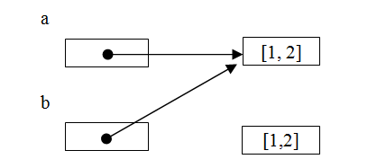
clone()
public class ObjectAssignment {
public static void main(String[] args) {
Car a = new Car(1,2);
Car b = new Car(1,2);
b = a;
if (a==b) {
System.out.println("a and b point to the same car.");
} else{
System.out.println("a and b point to different cars.");
}
}
}
This kind of copy is known as a "shallow copy"

Slide 108
clone()
public class Car implements Cloneable {
public Car() {
this(0, 0);
currentLocation = new Point(0,0);
}
public Car(double width, double height) {
this.width = width;
this.height = height;
currentLocation = new Point(0,0);
}
Cloneable是标记型接口，它们内部都没有方法和属性，implements Cloneable表示该对象能被克隆，能使用Object.clone()方法。如果没有implements Cloneable的类调用Object.clone()方法就会抛出CloneNotSupportedException。

Slide 109
clone()
public Car clone() {
Car cloned = null;
try {
cloned = (Car) super.clone();
} catch (CloneNotSupportedException e) {
System.err.println("Car object can't be cloned.");
return null;
}
return cloned;
}

Slide 110
clone()
public String toString() {
return "[width= " + width + ", height = " + height + ", Location=" + currentLocation + "]";
}
public void setLocation(Point p) {
currentLocation.setXY(p.getX(), p.getY());
}
public void setLocation(int x, int y) {
currentLocation.setXY(x, y);
}
private double width, height;
private Point currentLocation; // The current location of this object
}

Slide 111
clone()
public class CloneTest {
public static void main(String[] args) {
Car e1 = new Car(1, 2);
Car e2 = e1.clone();
e1.setLocation(3, 4);
System.out.println("Car=" + e1);
System.out.println("copy=" + e2);
}
}
It displays:
Car=[width= 1.0, height = 2.0, Location=[3, 4]]
copy=[width= 1.0, height = 2.0, Location=[3, 4]]

Slide 112
clone()
Car=[width= 1.0, height = 2.0, Location=[3, 4]]
copy=[width= 1.0, height = 2.0, Location=[3, 4]]
Car=[width= 1.0, height = 2.0, Location=[5, 6]]
copy=[width= 1.0, height = 2.0, Location=[5, 6]]
public class CloneTest2 {
public static void main(String[] args) {
Car e1 = new Car(1, 2);
e1.setLocation(3, 4);
Car e2 = e1.clone();
System.out.println("Car=" + e1);
System.out.println("copy=" + e2);
e2.setLocation(5,6);
System.out.println("Car=" + e1);
System.out.println("copy=" + e2);
}
}

Slide 113
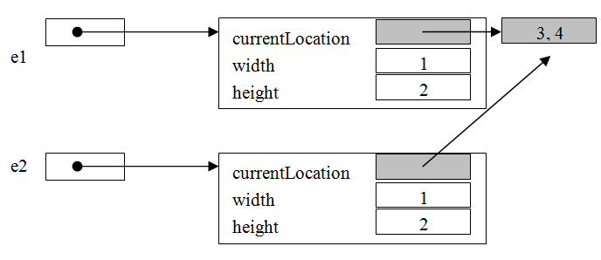
clone()
We have to clone "currentLocation" explicitly:

Slide 114
clone()
public class Point implements Cloneable {
public Point() {
}
public Point(int xValue, int yValue) {
x = xValue;
y = yValue;
}
// return x from coordinate pair
public int getX() {
return x;
}
// return y from coordinate pair
public int getY() {
return y;
}
public void setXY(int x, int y) {
this.x = x;
this.y = y;
}

Slide 115
clone()
public Point clone() {
Point cloned = null;
try {
cloned = (Point) super.clone();
} catch (CloneNotSupportedException e) {
System.err.println("Point object can't be cloned.");
return null;
}
return cloned;
}

Slide 116
clone()
public String toString() {
return "[" + getX() + ", " + getY() + "]";
}
private int x; // x part of coordinate pair
private int y; // y part of coordinate pair
}

Slide 117
clone()
public class Car implements Cloneable {
public Car() {
this(0, 0);
currentLocation = new Point(0, 0);
}
public Car(double width, double height) {
this.width = width;
this.height = height;
currentLocation = new Point(0, 0);
}

Slide 118
clone()
public Car clone() {
Car cloned = null;
try {
cloned = (Car) super.clone();
cloned.currentLocation = currentLocation.clone();
} catch (CloneNotSupportedException e) {
System.err.println("Car object can't be cloned.");
return null;
}
return cloned;
}
public String toString() {
return "[width= " + width + ", height = " + height + ", Location="
+ currentLocation + "]";
}

Slide 119
clone()
public void setLocation(Point p) {
currentLocation.setXY(p.getX(), p.getY());
}
public void setLocation(int x, int y) {
currentLocation.setXY(x, y);
}
private double width, height;
private Point currentLocation; // The current location of this object
}

Slide 120
clone()
Now if we run CloneTest2.java again, it displays:
Car=[width= 1.0, height = 2.0, Location=[3, 4]]
copy=[width= 1.0, height = 2.0, Location=[3, 4]]
Car=[width= 1.0, height = 2.0, Location=[3, 4]]
copy=[width= 1.0, height = 2.0, Location=[5, 6]]

Slide 121
Comparison of Objects
The two operators that can be used with object references are comparing for equality (==) and inequality (!=).
These operators compare two values to see if they refer to the same object.

Slide 122
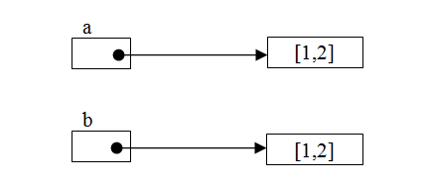
Comparison of Objects
Car a = new Car(1,2);
Car b = new Car(1,2);
if (a==b) {
System.out.println("a == b");
} else{
System.out.println("a <> b");
}

Slide 123
Comparison of Objects
Use the equals() method to compare object values.
The equals() method returns a boolean value.
Because this method is defined in the Object class, from which all other classes are derived, it is automatically defined for every class.
However, it doesn't perform an intelligent comparison for most classes unless the class overrides it.
It has been defined in a meaningful way for most Java core classes.
If it's not defined for a (user) class, it behaves the same as ==.

Slide 124
Comparison of Objects
Car a = new Car(1, 2);
Car b = new Car(1, 2);
if (a.equals(b) ) {
System.out.println(" a = b");
} else {
System.out.println(" a <> b");
}
a <> b.

Slide 125
Comparison of Objects
Class Car has to override the equals() in class Object and declare exactly what the meaning of equality is for Car.
In the following code, the class Car defines that if two objects have same width, height and position, they are equal:

Slide 126
Comparison of Objects
public class Car extends Vehicle {
public int getWidth() {
return width;
}
…
public int getHeight() {
return height;
}
public boolean equals(Object o) {
Car rec = (Car)o;
if (this.getLocation().equals(rec.getLocation())
&& ( this.width == rec.getWidth() )
&& ( this.height == rec.getHeight()) ){
return true;
} else {
return false;
}
}
private int width, height;
}
public class Point {
…
public boolean equals(Object o) {
Point p = (Point)o;
if ( (this.x == p.getX()) && (this.y == p.getY()) ) {
return true;
} else {
return false;
}
}
private int x; // x part of coordinate pair
private int y; // y part of coordinate pair
}

Slide 127
Comparison of Objects
Many built-in classes provide an equals() method. For example:
Integer a = new Integer(1);
Integer b = new Integer(1);
if (a.equals(b)) {
System.out.println("a == b");
} else{
System.out.println("a <> b");
}

Slide 128
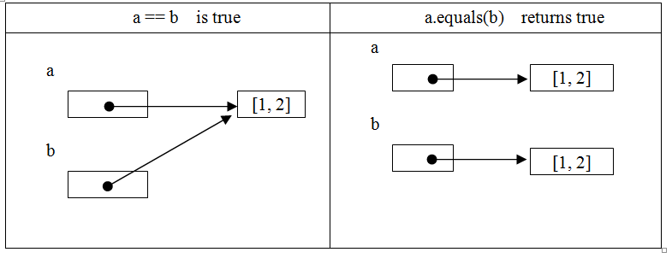
Comparison of Objects

Slide 129
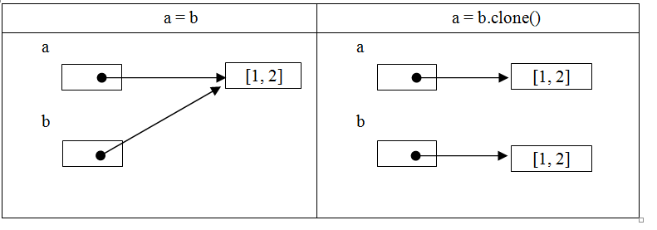
Comparison of Objects

Slide 130
Inner Class 内部类
Java语言允许在类中定义内部类，内部类就是在其他类内部定义的子类。
一般格式为：
内部类有以下4种形式：
成员内部类
局部内部类
静态内部类
匿名内部类
public class Zoo{
class Wolf{ // 内部类Wolf
}
}

Slide 131
成员内部类
成员内部类和成员变量一样，属于类的全局成员。
一般格式为：
注意：成员变量id定义为公有属性public，但是内部类Inner不可以使用public修饰符，因为公共类的名称必须与类文件同名，所以每个Java类文件中只允许存在一个public公共类。
public class Sample {
public int id; // 成员变量
class Inner{ // 成员内部类
}
}

Slide 132
成员内部类
Inner内部类和变量id都被定义为Sample类的成员，但是Inner成员内部类的使用要比成员变量复杂一些。
一般格式为：
只有创建了成员内部类的实例，才能使用成员内部类的变量和方法。
Sample sample = new Sample();
Sample.Inner inner = sample.new Inner();

Slide 133
局部内部类
局部内部类和局部变量一样，都是在方法内定义的，其有效范围只在方法内部有效。
一般格式为：
局部内部类可以访问它的创建类中的所有成员变量和成员方法，包括私有方法。
public void sell() {
class Apple { // 局部内部类
}
}

Slide 134
静态内部类
静态内部类和静态变量类似，它都使用static关键字修饰。
一般格式为：
静态内部类可以在不创建Sample对象的情况下直接使用。
public class Sample {
static class Apple { // 静态内部类
}
}

Slide 135
匿名内部类
匿名类就是没有名称的内部类，它经常被应用于Swing程序设计中的事件监听处理。
一般格式为：
例如创建一个匿名的Apple类，可以使用如下代码：
new ClassName(){……}
public class Sample {
public static void main(String[] args) {
new Apple() {
public void introduction() {
System.out.println("这是一个匿名类，但是谁也无法使用它。");
}
};
}
}

